Slide 1

1. Introduction to the Tidyverse
Jonathan Hersh, PhD (Chapman Argyros School of Business)
12/7/20

Slide 2
Section 1: Outline
Loading data
Glimpse to view
Pipe operator
slice() to select rows
arrange() to order data frame
select() to choose variables
rename() to rename variables
filter() to select rows matching characteristics
mutate() to create new variables
group_by() and summarize() to create group

Slide 3
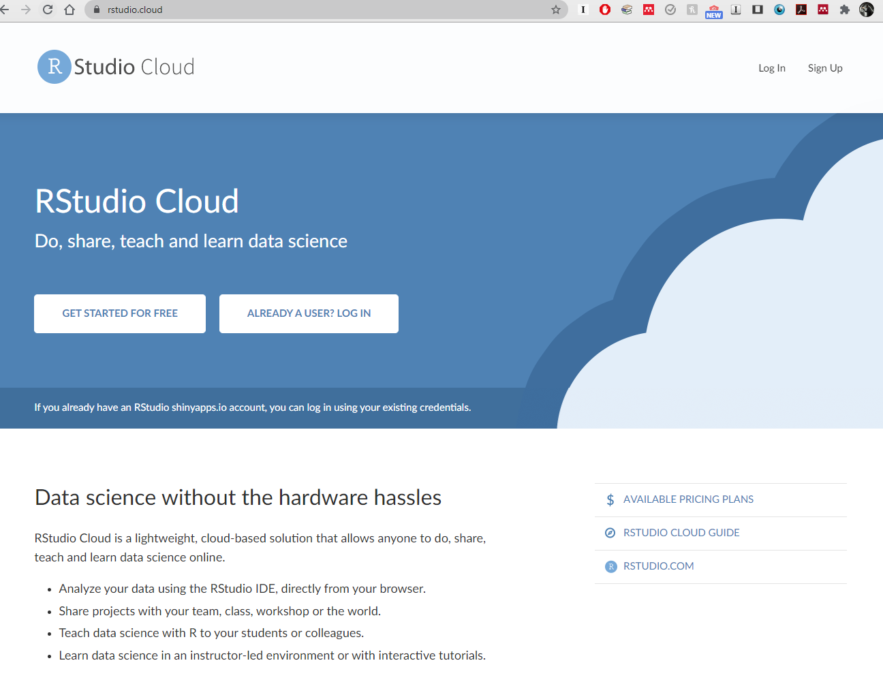
R Studio Cloud
Go to rstudio.cloud if your version of R is ever not working

Slide 4
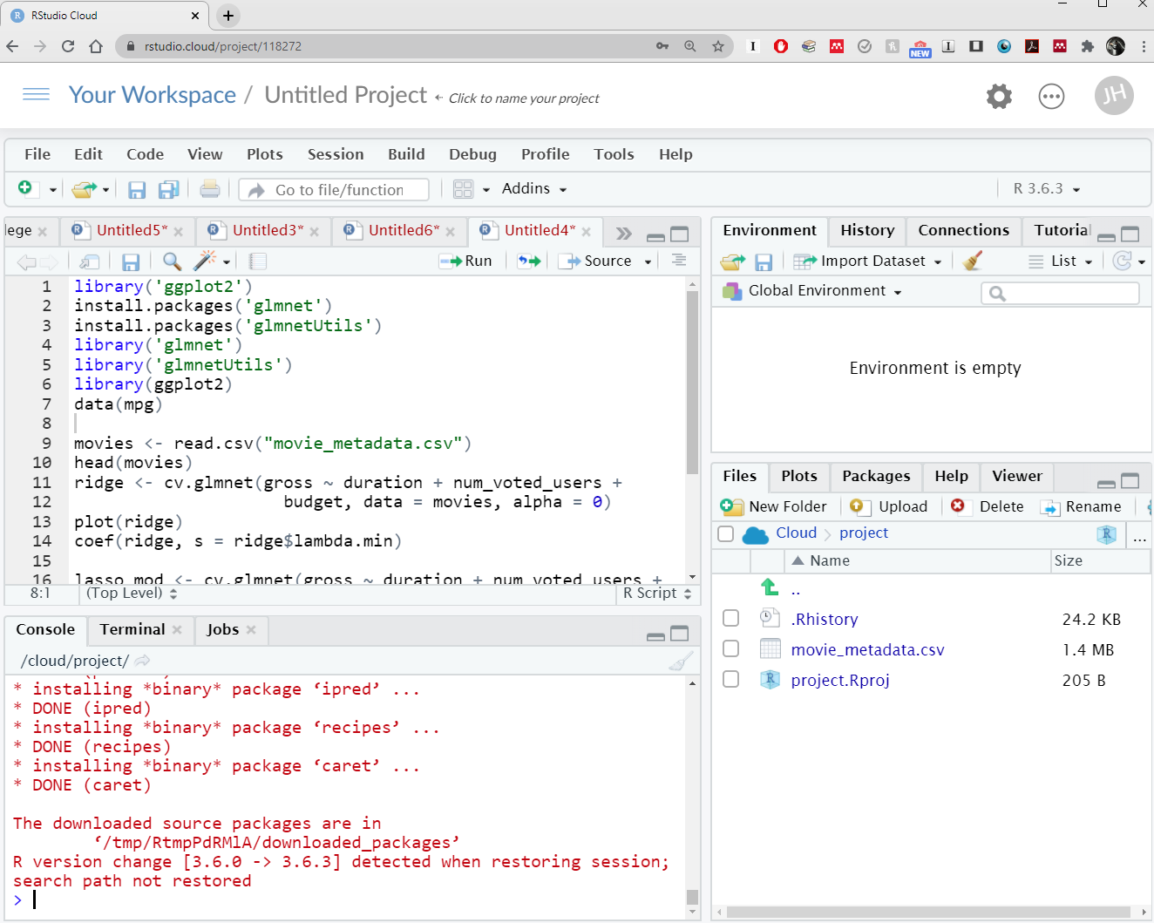
R Studio Cloud
R Studio Cloud is a full featured version of R in your browser!

Slide 5
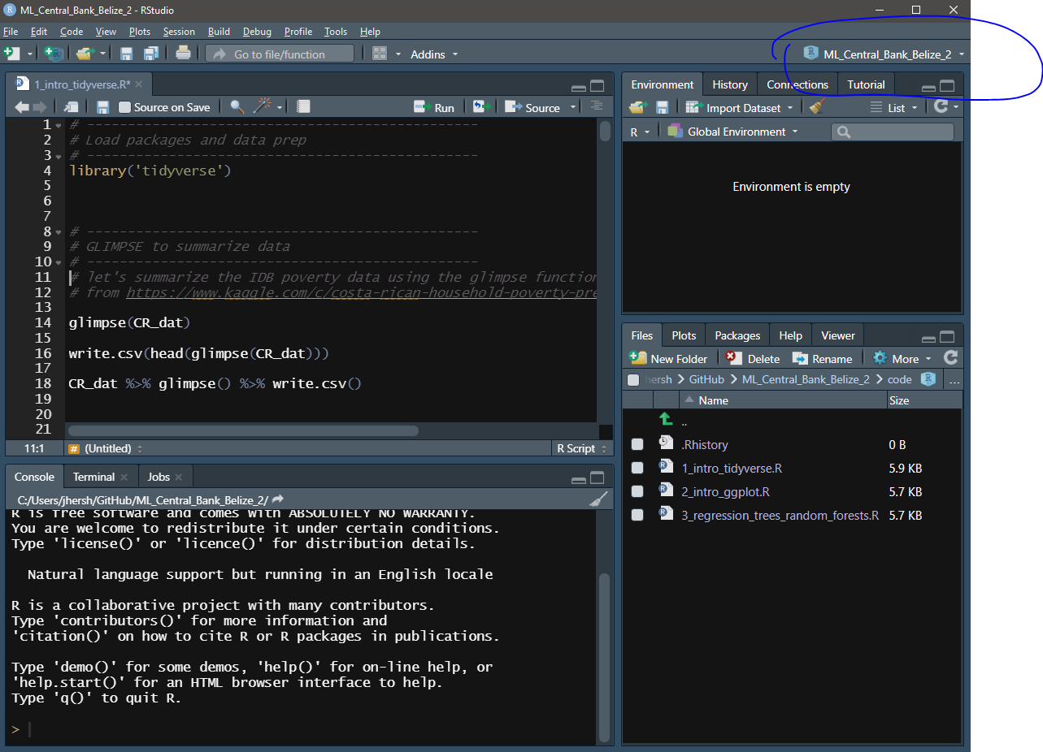
R Studio Projects
Be sure to work in a project file in R Studio

Slide 6
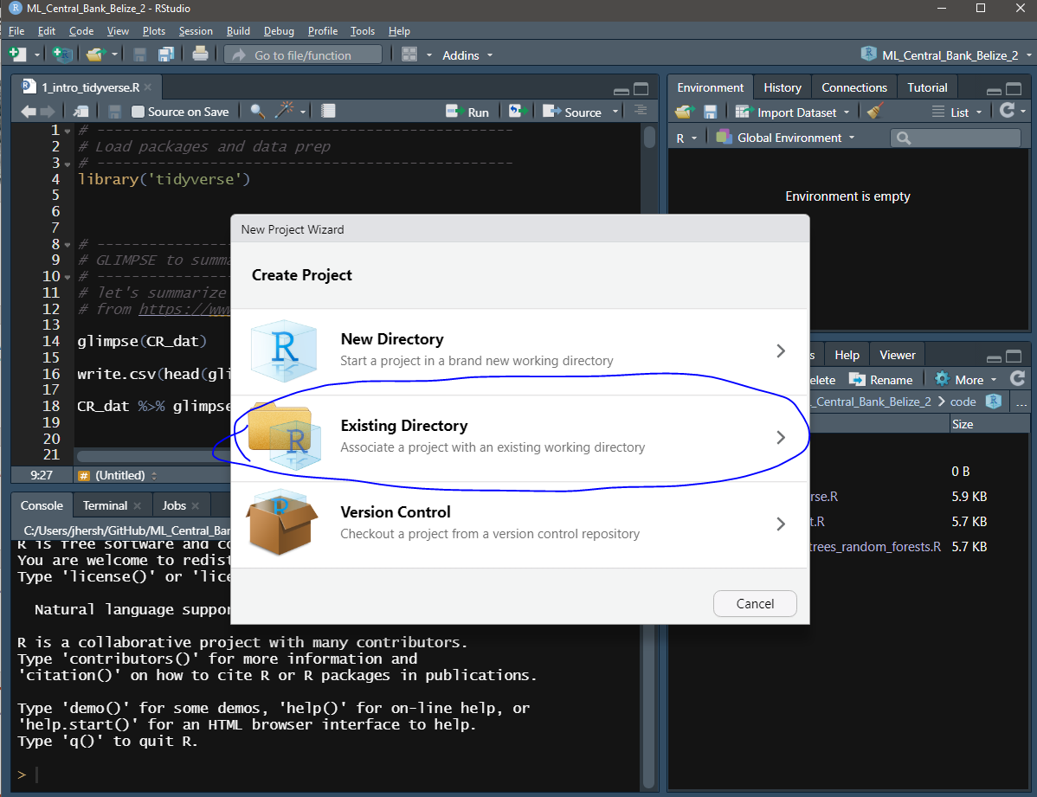
Creating an R Studio Project
Be sure to work in a project file in R Studio
Click file -> new project -> Existing Directory

Slide 7
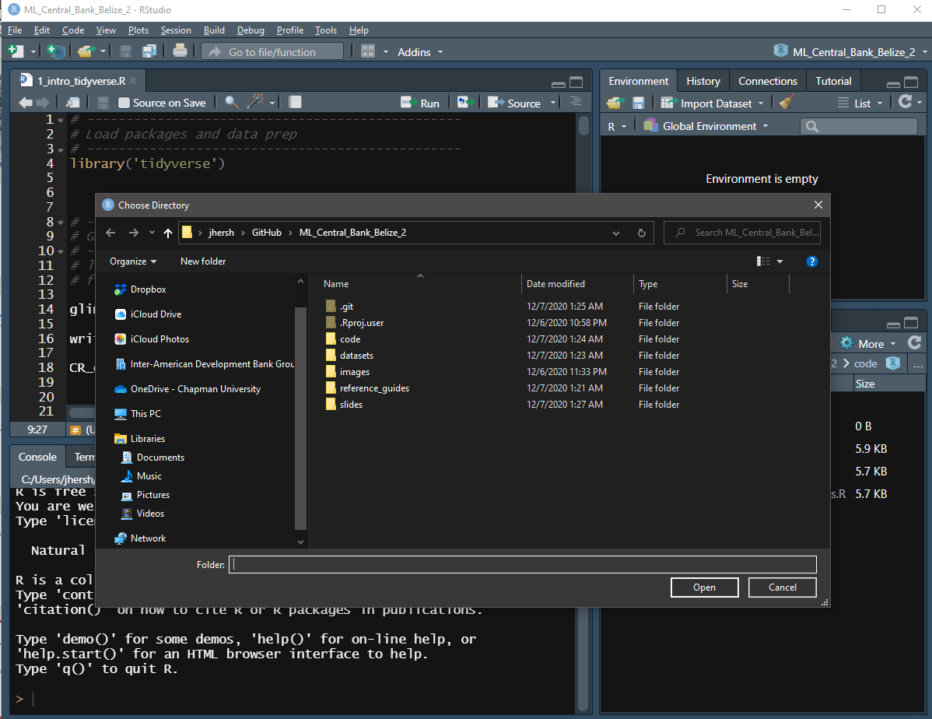
Creating an R Studio Project
Be sure to work in a project file in R Studio
Click file -> new project -> Existing Directory
Then navigate to the folder where you are storing all of today’s files

Slide 8
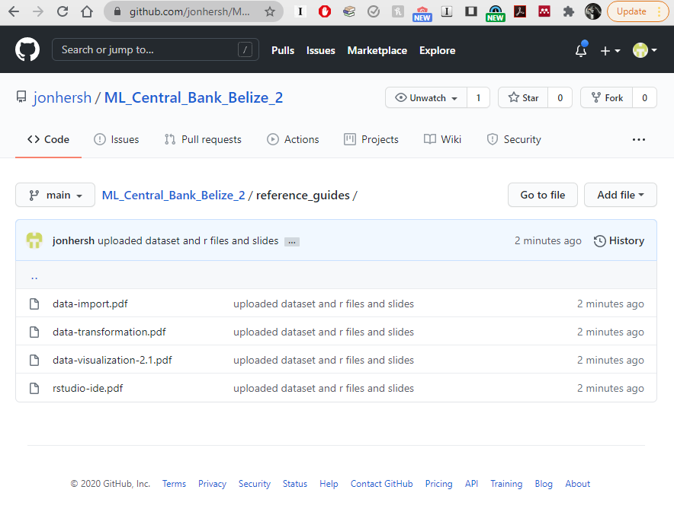
Reference Guides for Data Transformation, Import, Plotting and RStudio
https://rstudio.com/resources/cheatsheets/

Slide 9
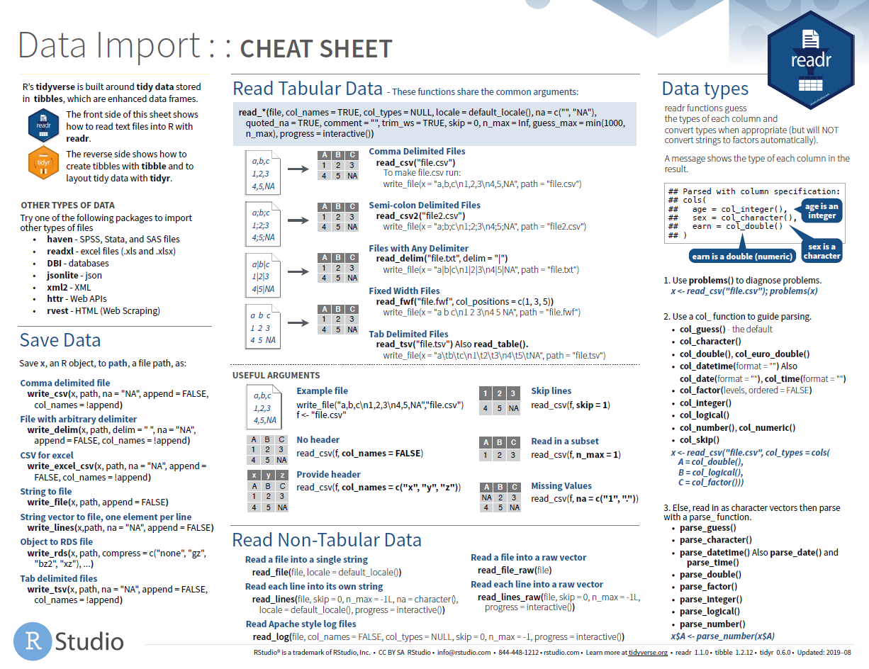

Slide 10
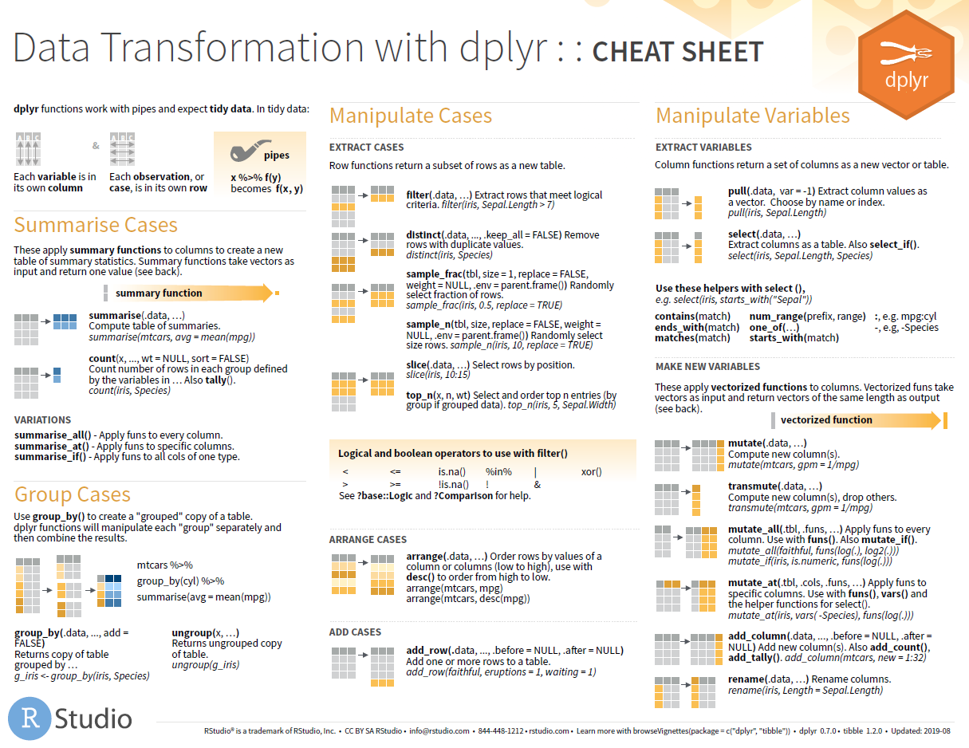

Slide 11
